Slide 1
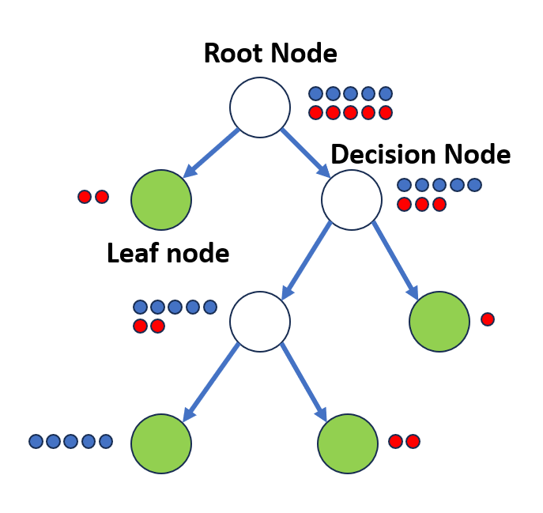

Slide 2
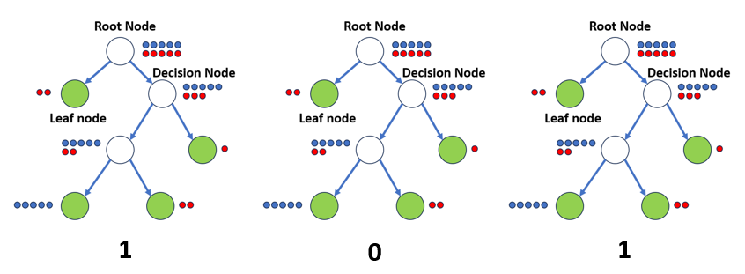
Prediction after majority voting: 1

Slide 3
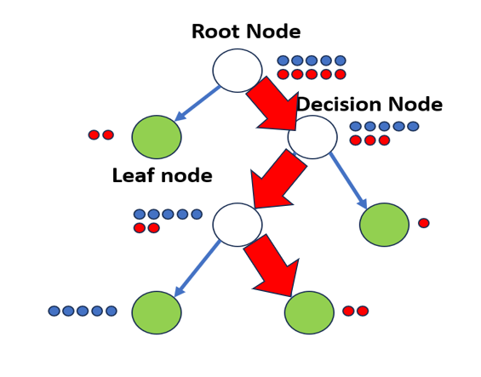
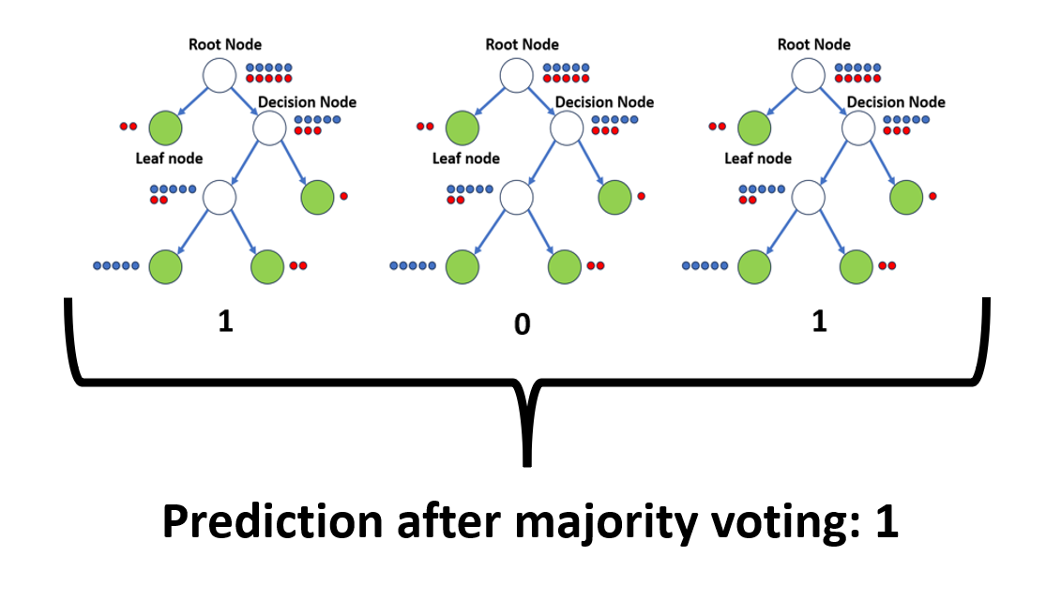
Prediction with a decision tree
Structure of a decision tree

Slide 4
Prediction with a decision tree

